Slide 1



Computer Repair Store
By: Group 6
Amber Robertson
Curran Buss
Brian Thompson

Slide 2
Responsibilities
Amber:
Create scene builder and buttons
Code for buttons
Curran:
Database
Code for buttons
Brian:
Pictures for inventory with scene builder container for them
Linking pictures to project

Slide 3
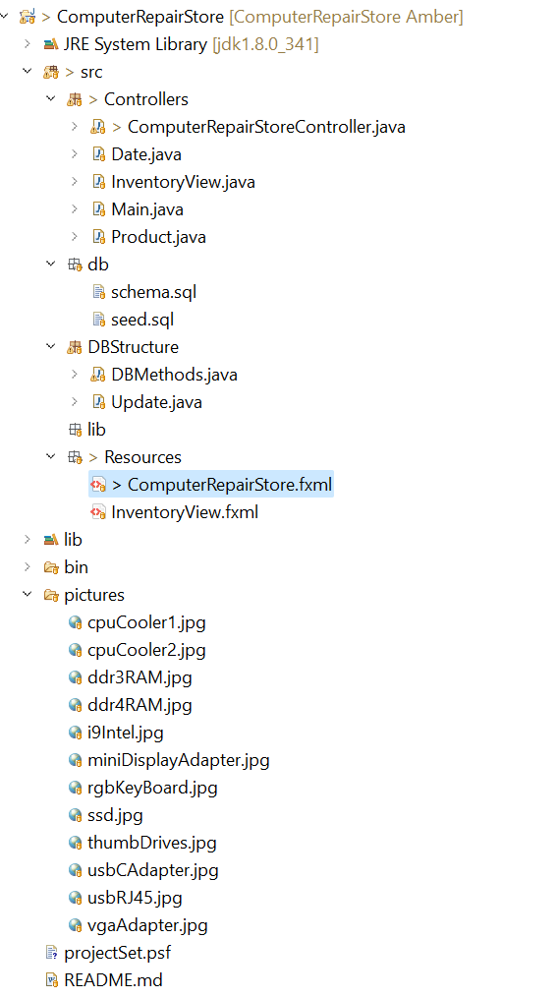

Slide 4
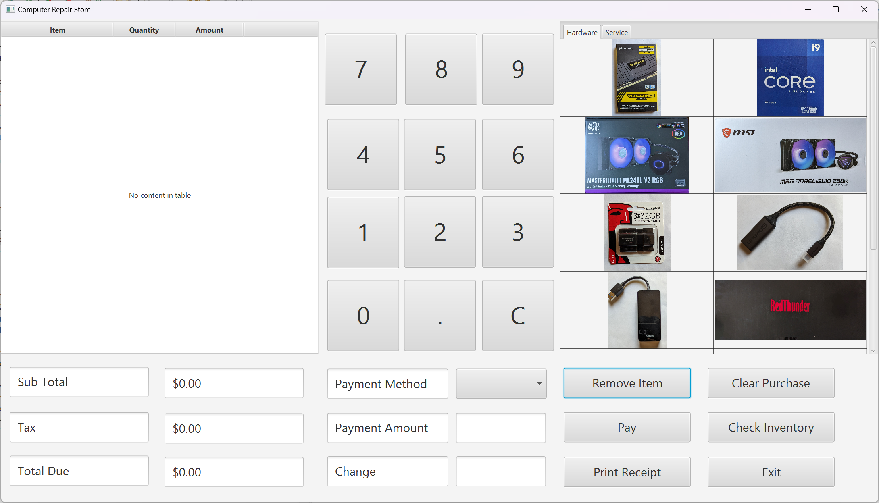

Slide 5
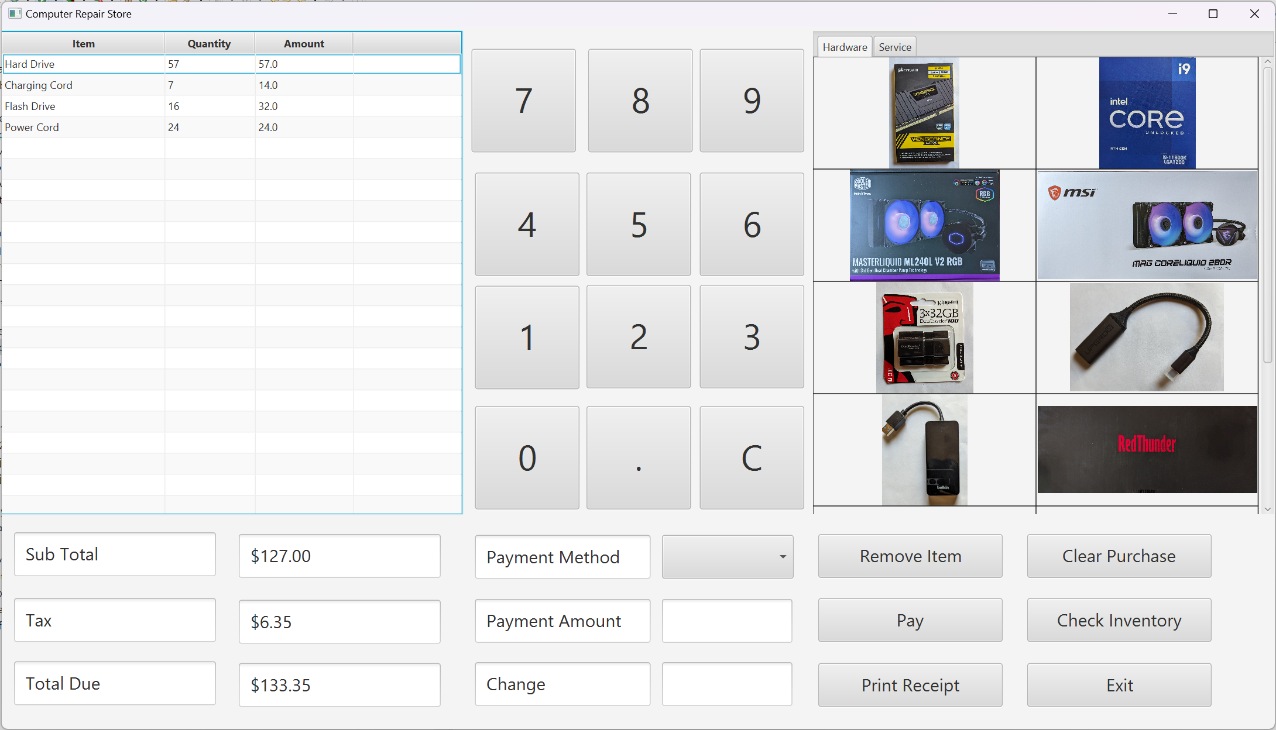

Slide 6

Remove Item and Enter Payment

Slide 7


Slide 8
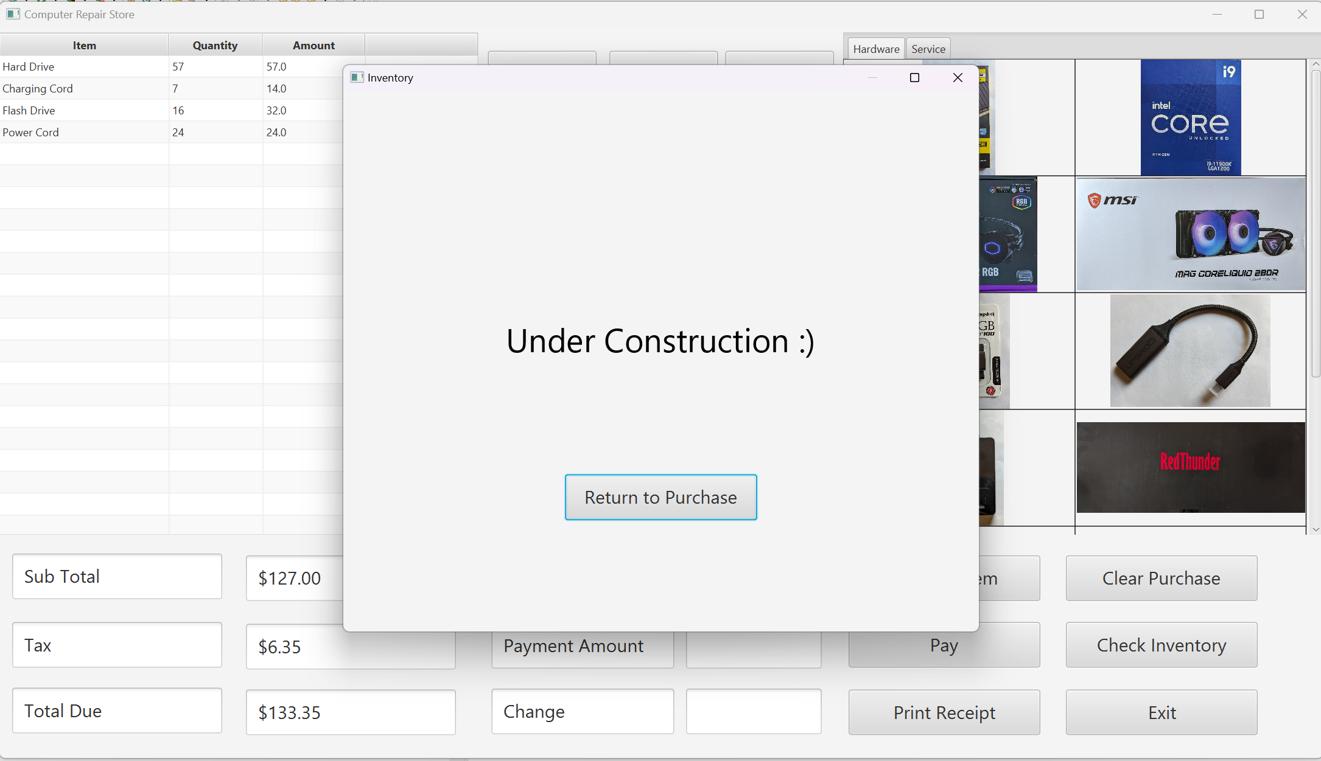
Check inventory

Slide 9
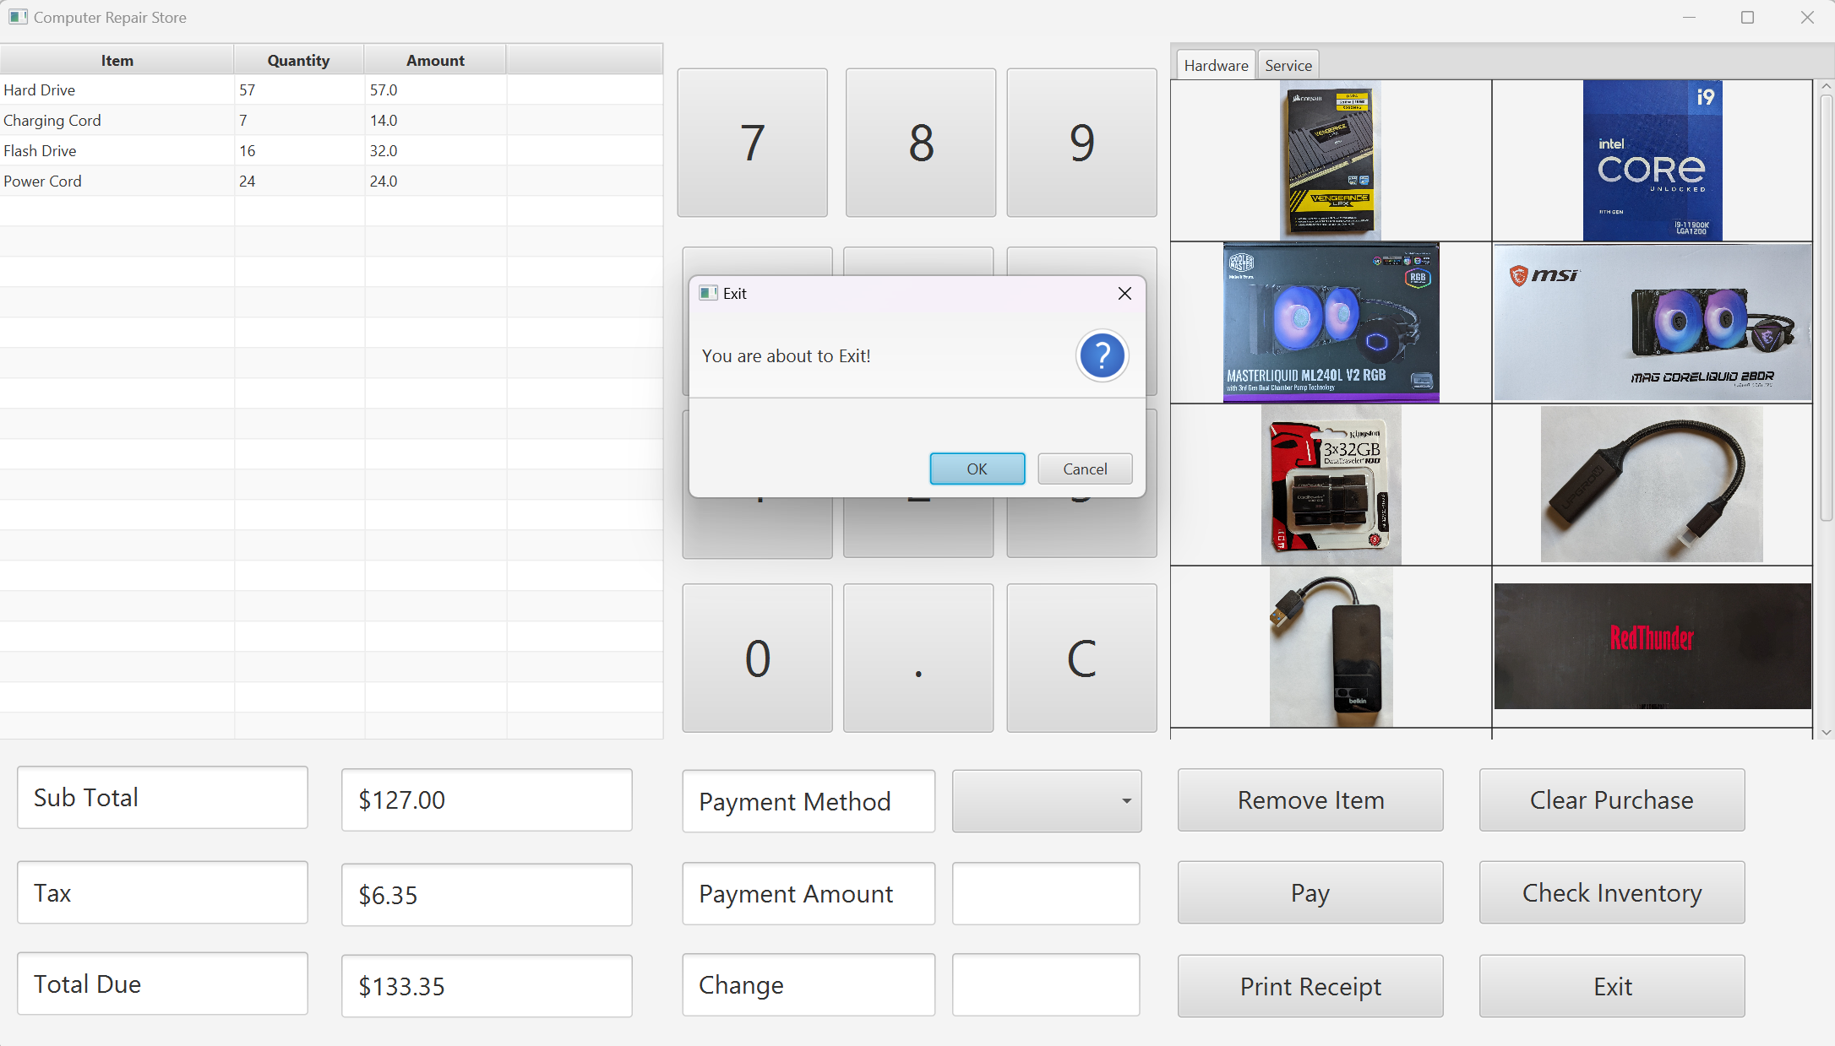
Exit

Slide 10
Upcoming features
Clickable pictures that add item to purchase list
Fix Clear Purchase button to clear the total when the list is cleared
Working Print Receipt Button
Inventory Screen:
Ability to view the inventory
Update when items are added to or deleted from the purchase list

